Slide 1
Optimal control of trajectory of reusable launcher in OpenMDAO/dymos
Students:
Alberto Fossà
Giuliana Elena Miceli
Tutors:
Laurent Beauregard
Joseph Morlier
Stéphanie Lizy-Destrez
June 25th 2019

Slide 2
Outline
Context
Optimal control problem
State of the Art
2D Ascent Trajectory
2D Descent Trajectory
3D Ascent Trajectory
Conclusions & Future achievements

Slide 3
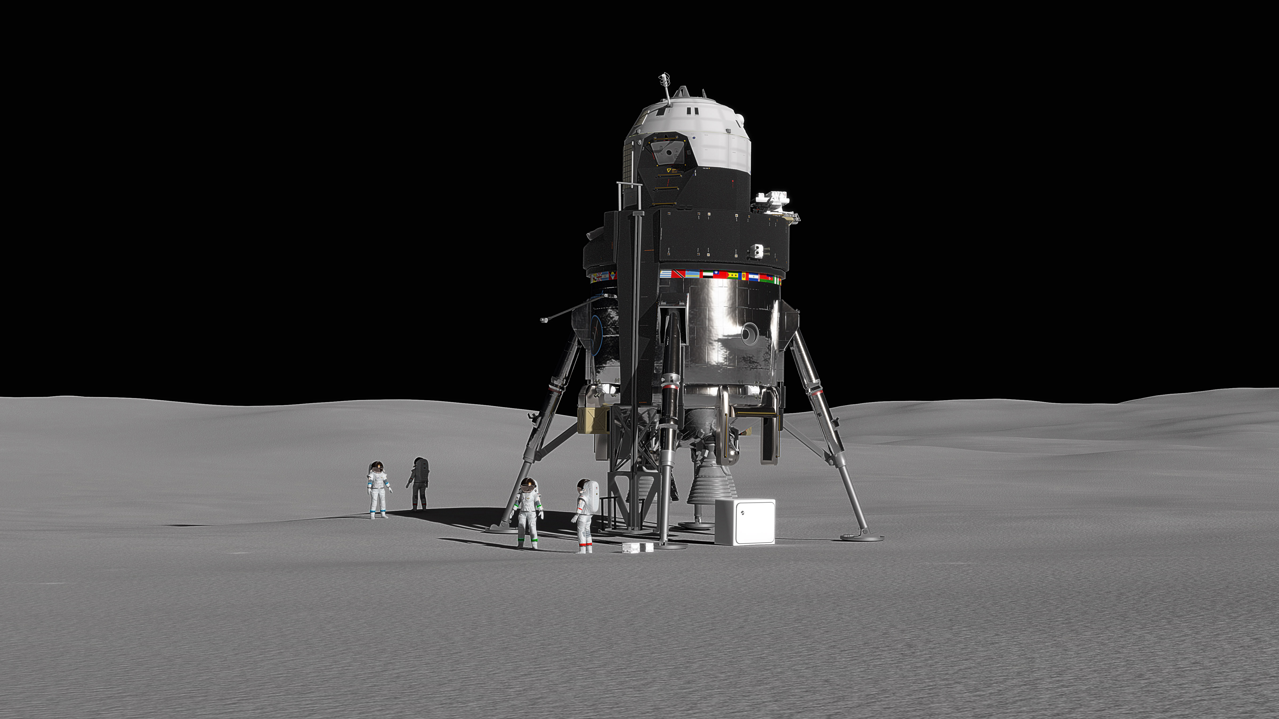
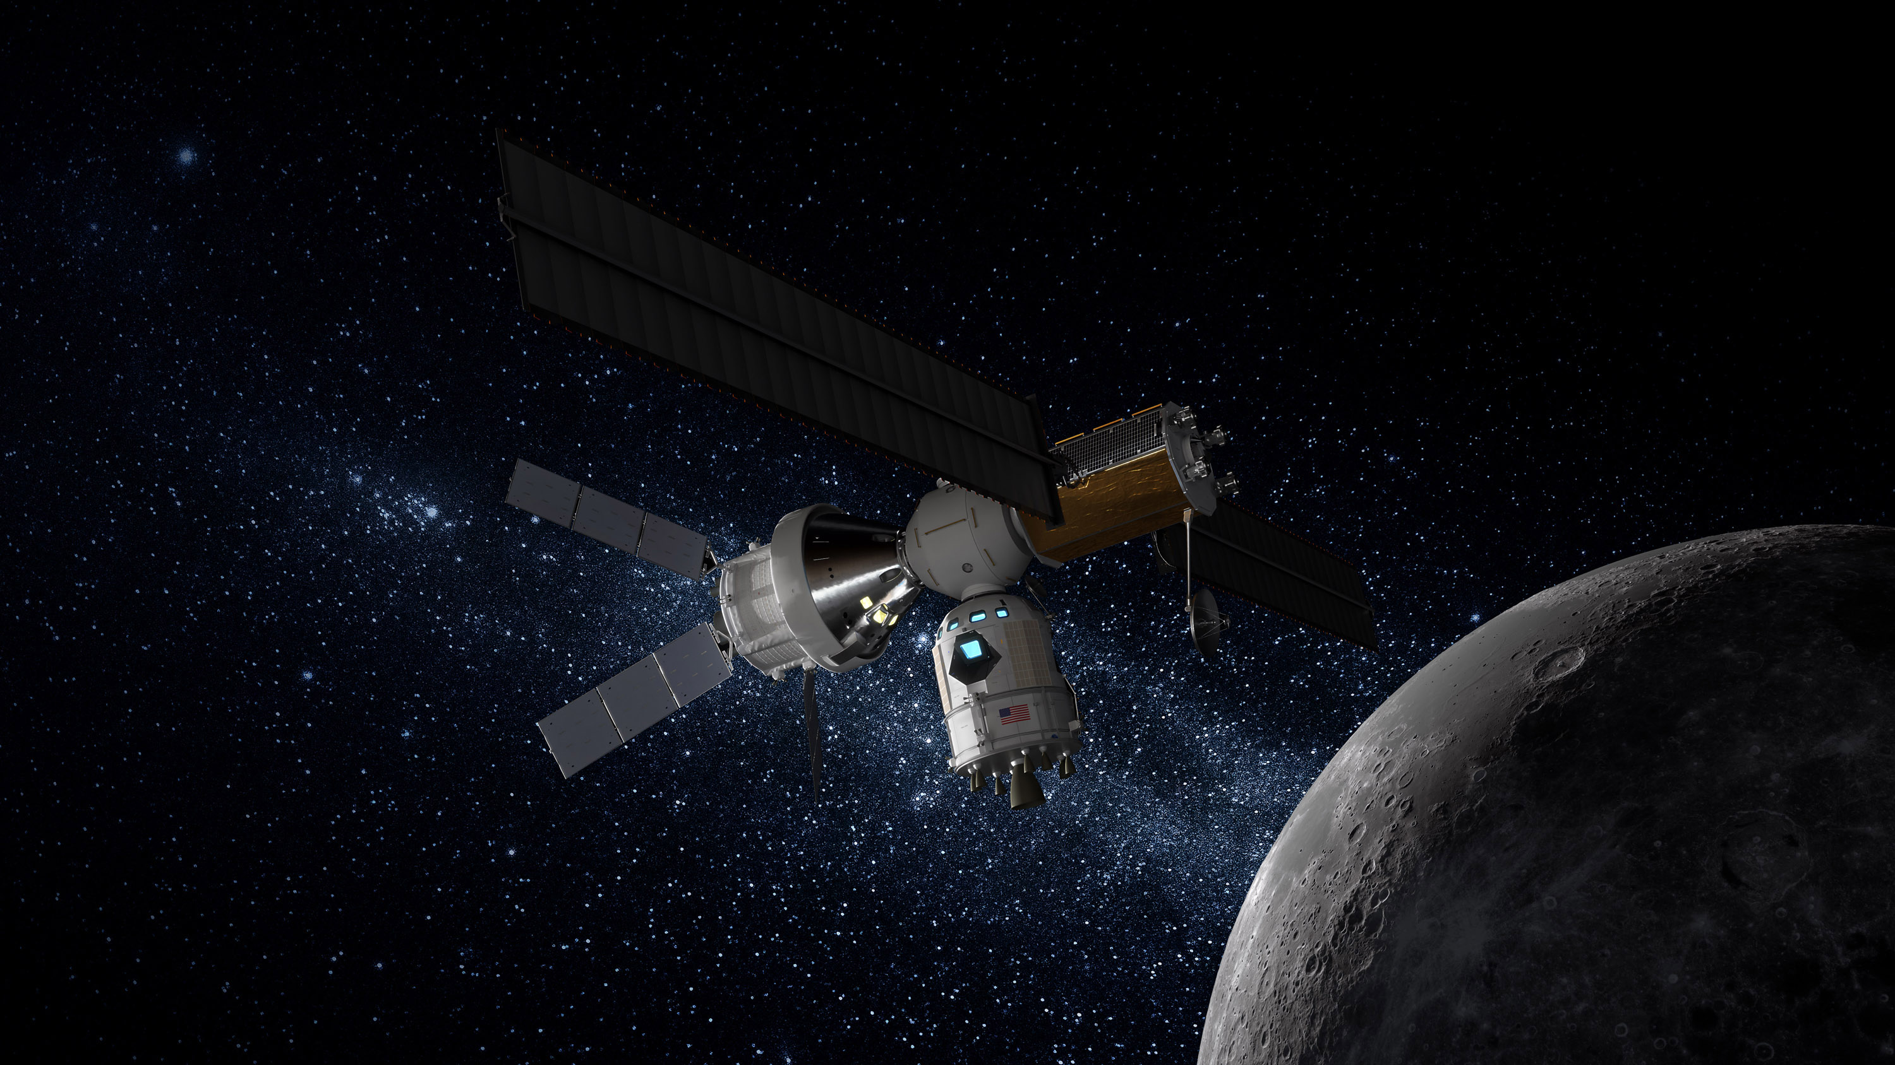
Context
Moon and Mars Exploration
In-situ resources exploitation
Lunar Orbital Platform Gateway
credits: Lockheed Martin

Slide 4
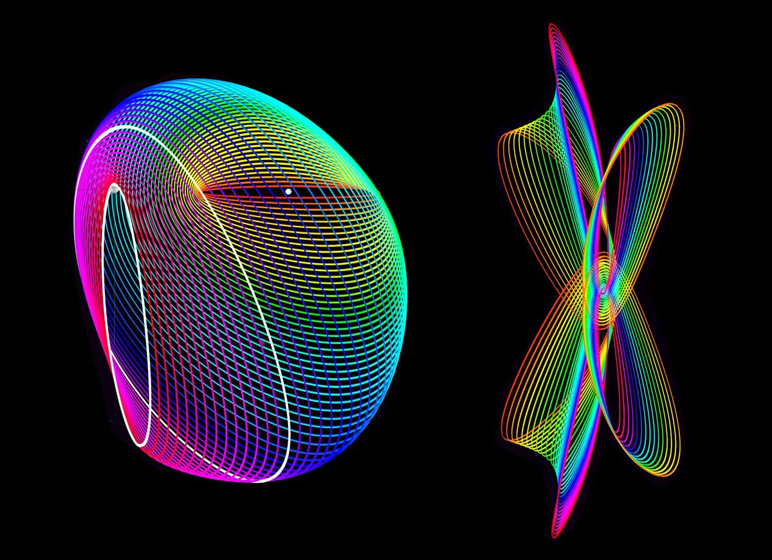
Context
HALO orbits
credits: Purdue University

Slide 5
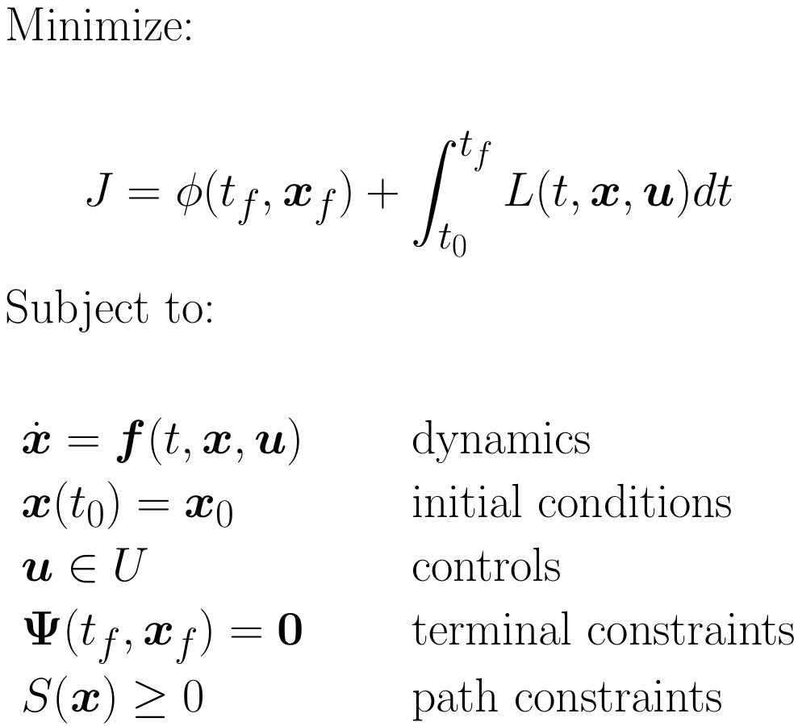
Optimal control problem: formulation
Mathematical formulation of a continuous-time optimal control problem

Slide 6
Optimal control problem: solution
Solution of an optimal control problem - indirect methods
Calculus of variations
Pros:
highly accurate solution
low computational effort
Euler-Lagrange first-order optimality conditions
Pontryagin Minimum Principle
Cons:
heavy algebraic manipulation of EOMs
small region of convergence
Two-Points Boundary Value Problem (TPBVP)

Slide 7
Optimal control problem: solution
Solution of an optimal control problem - direct methods
Direct transcription
States and controls discretization
Non Linear Programming problem (NLP)
Iterative solution
Collocation defects driven to zero
Pros:
no algebraic manipulation of EOMs
wider region of convergence
Cons:
high number of decision variables
high computational effort

Slide 8
State of the Art: Tools
Direct transcription methods:
High-Order Gauss-Lobatto
Radau Pseudospectral
Libraries:
GPOPS-II⁵ (MATLAB⁴)
OpenMDAO/dymos^{6,7} (Python)
NLP solvers:
Gradient-based (SNOPT¹, IPOPT^{2,3}, fmincon⁴)
Gradient-free (PSO, DE,SA)
¹Gill et al., SIAM Review, 2005
²Wächter et al., Mathematical Programming, 2006
³HSL, http://www.hsl.rl.ac.uk/
⁴Matworks, https://www.mathworks.com/
⁵Patterson et al., ACM Trans. Math. Softw., 2014
⁶Gray et al., Structural and Multidisciplinary Optimization, 20197
⁷Hendricks et al., AIAA, 2017

Slide 9
Implementation
Optimal control problem for spacecraft trajectory optimization
Direct transcription
High-Order Gauss-Lobatto, OpenMDAO/dymos library
NLP problem
IPOPT solver, linear solver MA57
Validation
IVP from initial conditions and optimal control profile, simulate method

Slide 10
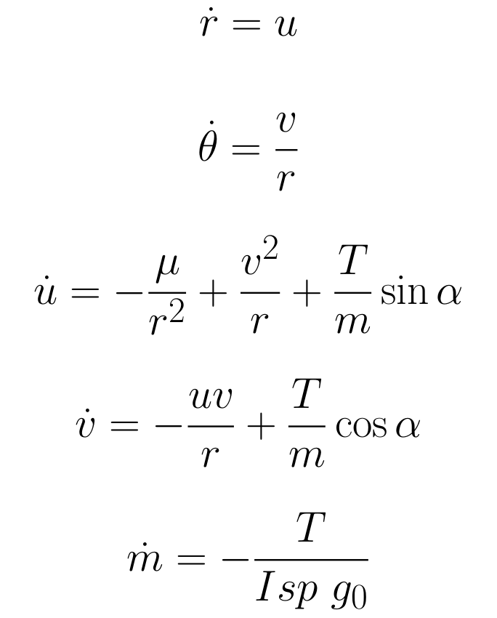
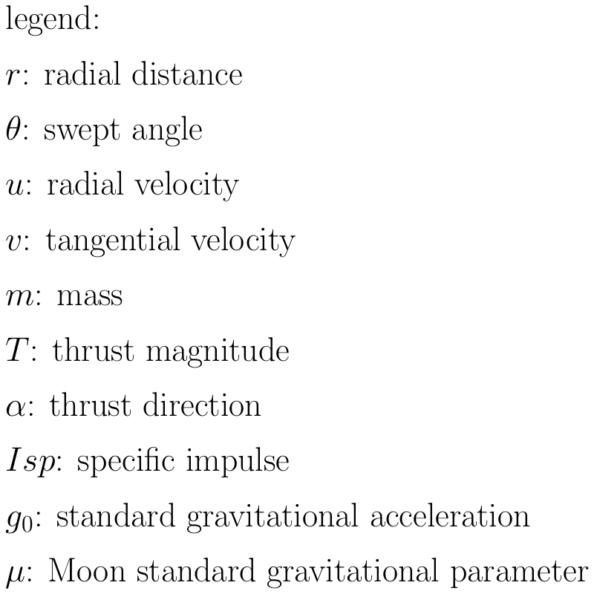
2D Ascent Trajectory: EOMs
Equations of motions (EOMs):
T
V
v
u
r
θ

Slide 11
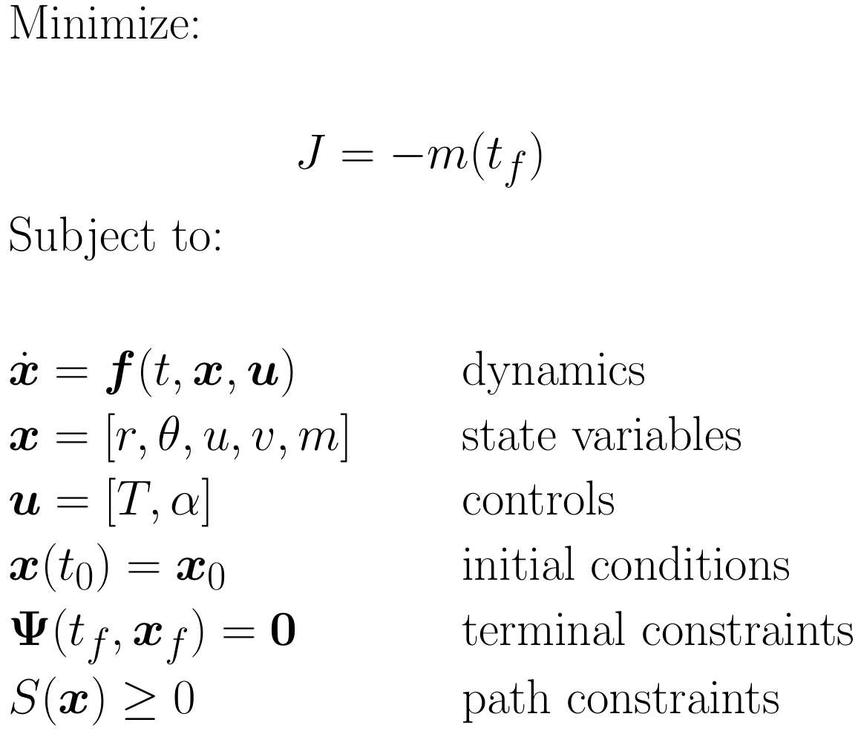
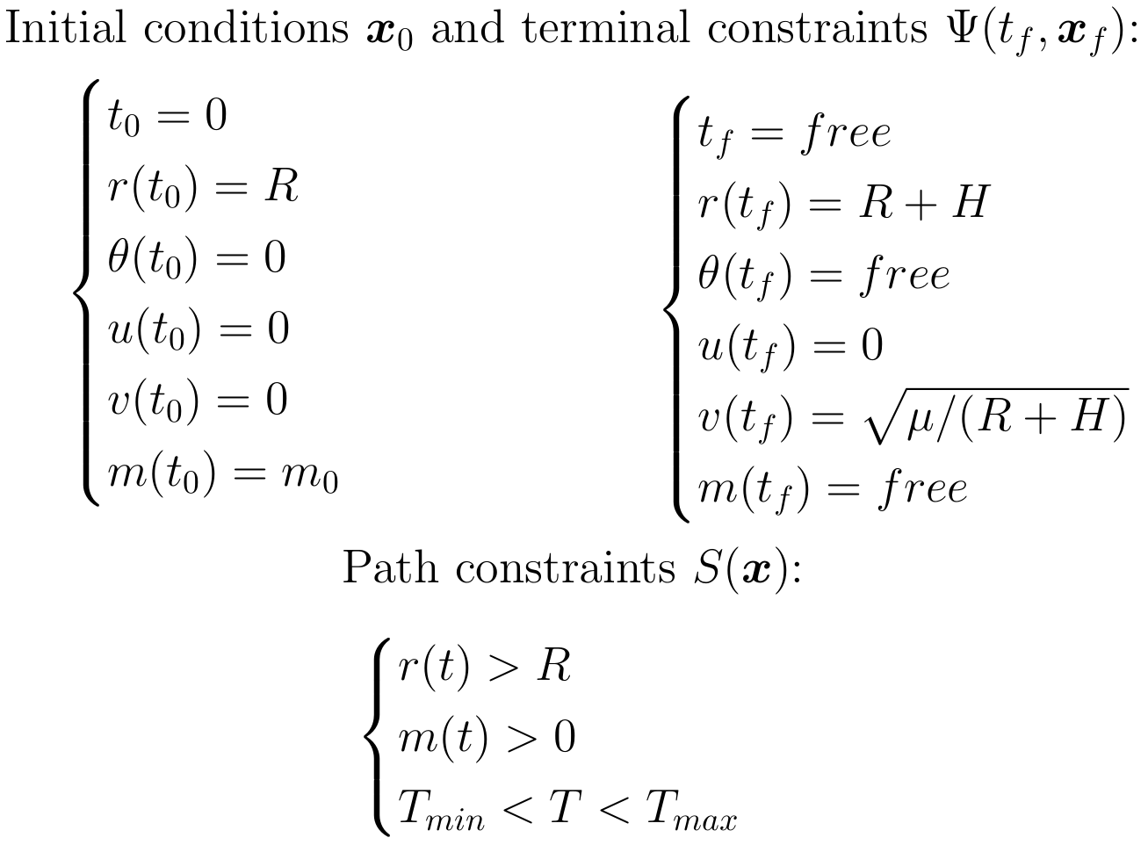
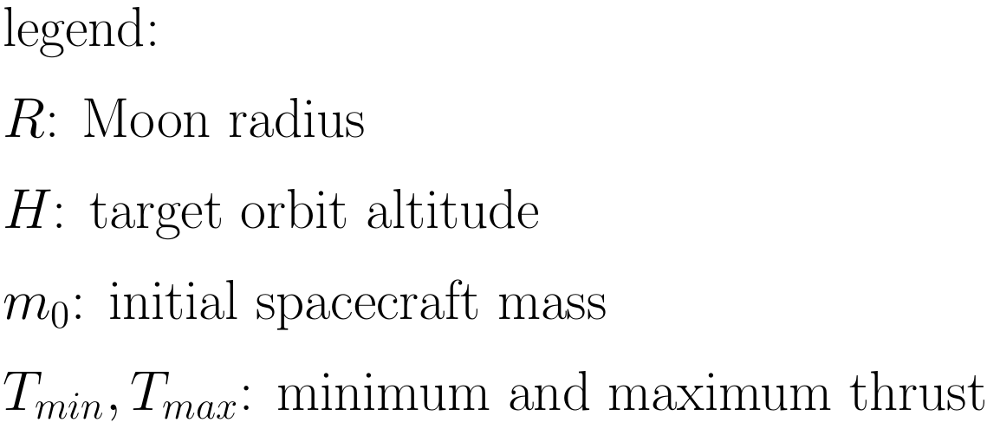
2D Ascent: Optimal control problem

Slide 12
2D Ascent: Solutions
Common parameters:
Target orbit altitude | 86.87 km
Isp | 450 s
Initial thrust/weight ratio | 2.1
Proposed solutions:
Ascent Trajectory | Time of Flight | Propellant consumption
Constant Thrust | 476.13 s | 36.80%
Variable Thrust | 3697.56 s | 33.64%
Semianalytic initial guess | 3803.26 s | 32.81%
Variable Thrust, Minimum safe altitude | 3367.77 s | 35.50%

Slide 13
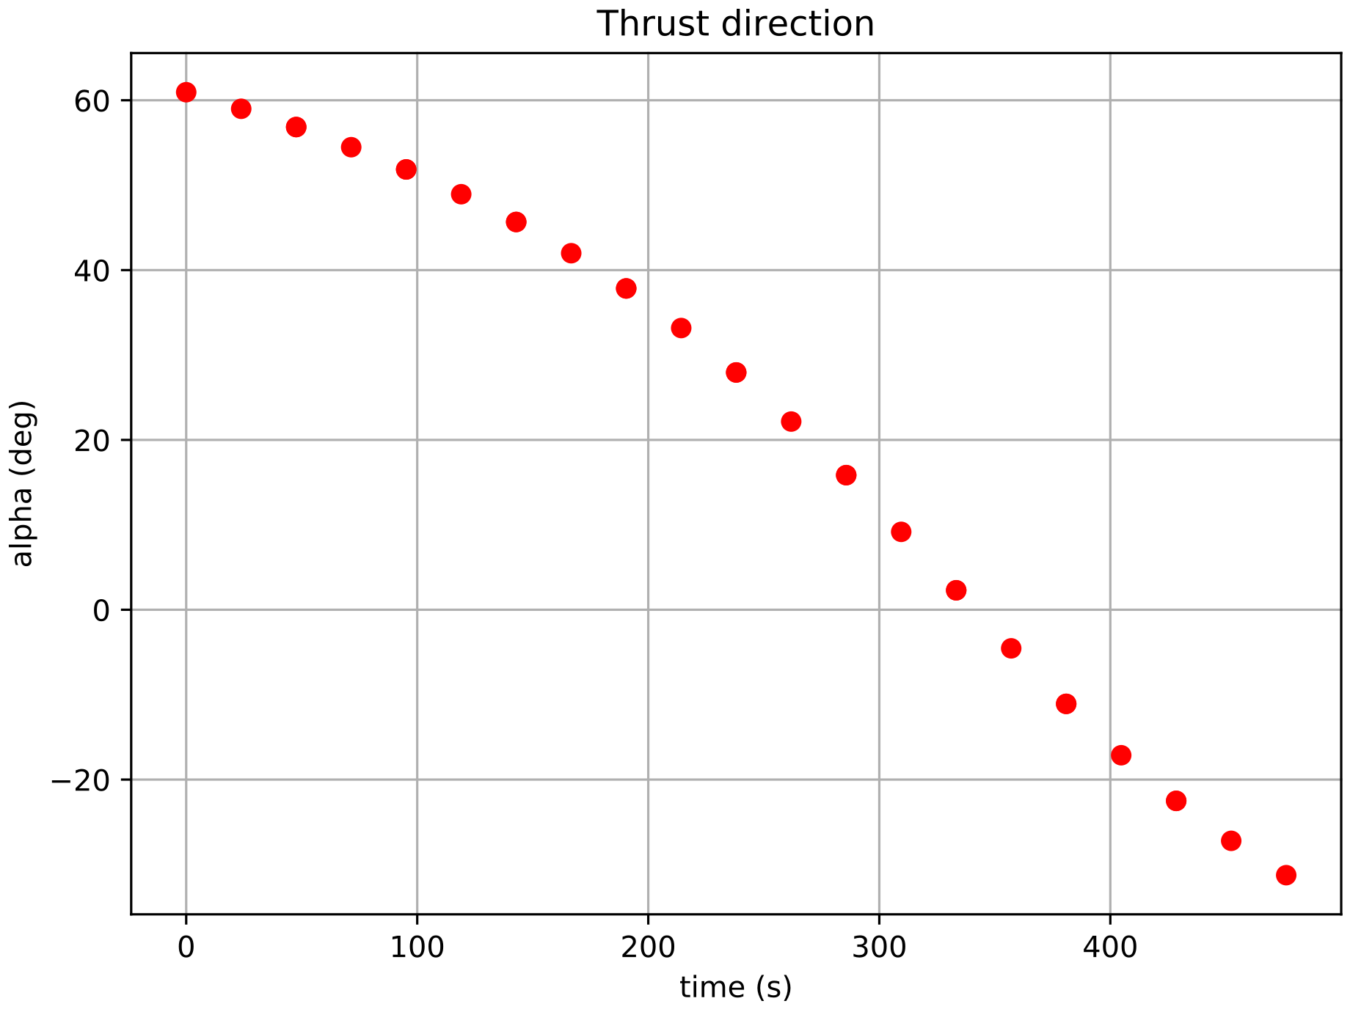
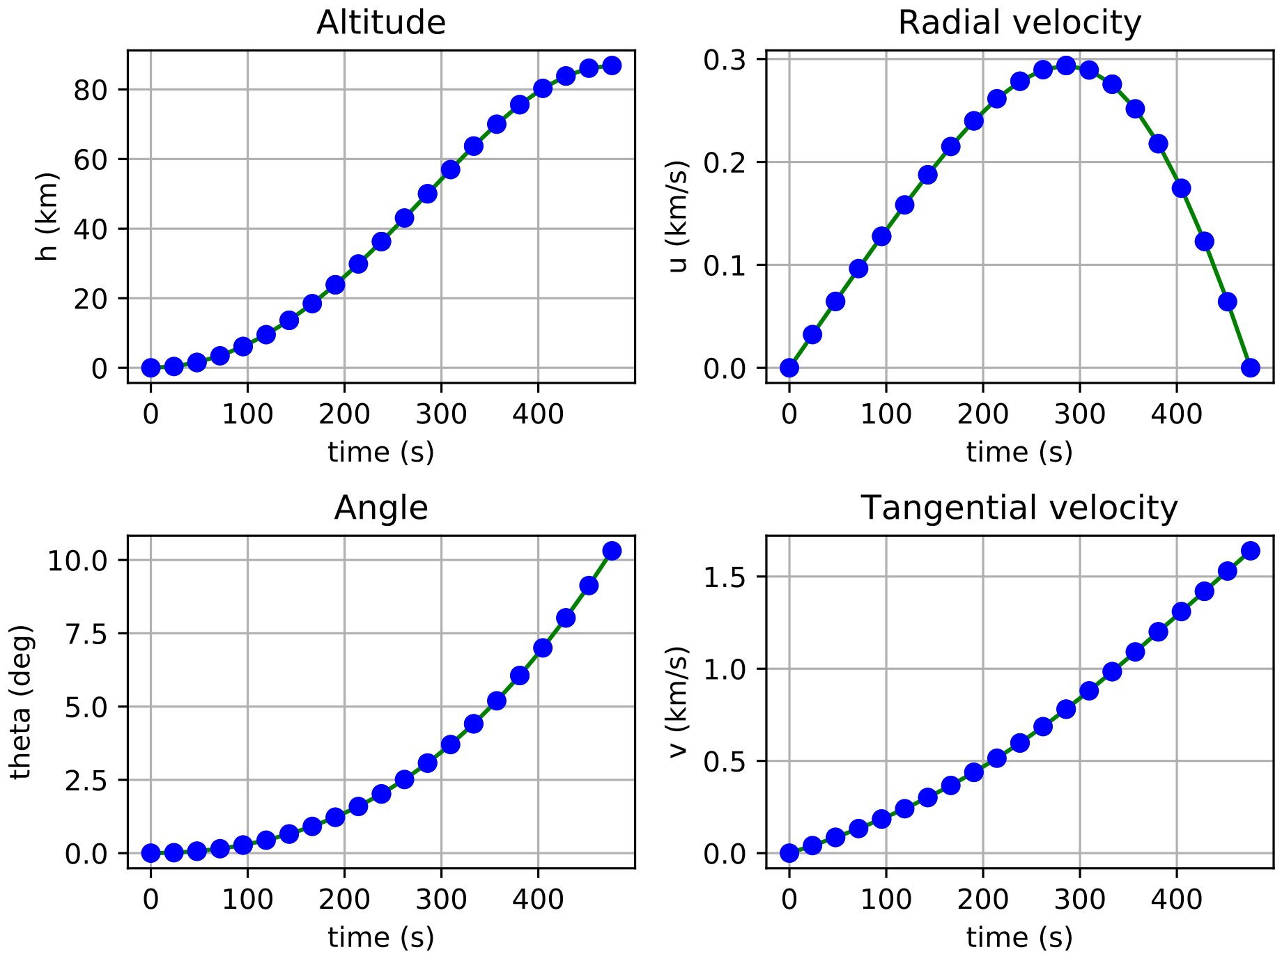
2D Ascent: Constant thrust
Time of Flight | Propellant consumption
476.13 s | 36.80%

Slide 14
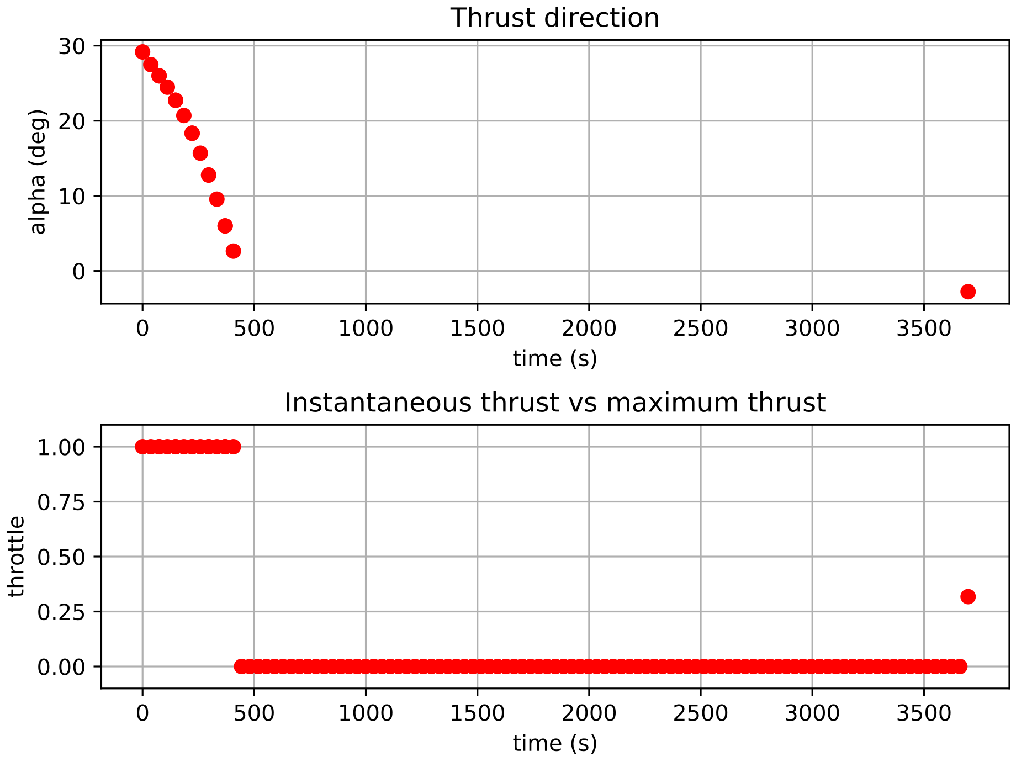
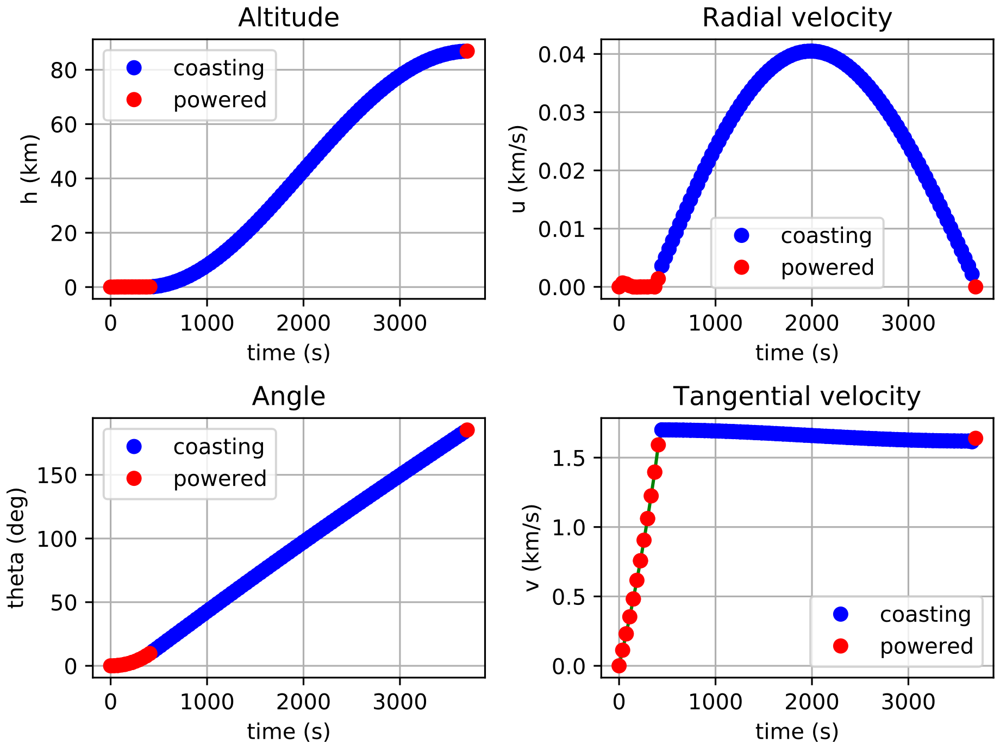
2D Ascent: Variable thrust
Time of Flight | Propellant consumption
3697.56 s | 33.64%

Slide 15
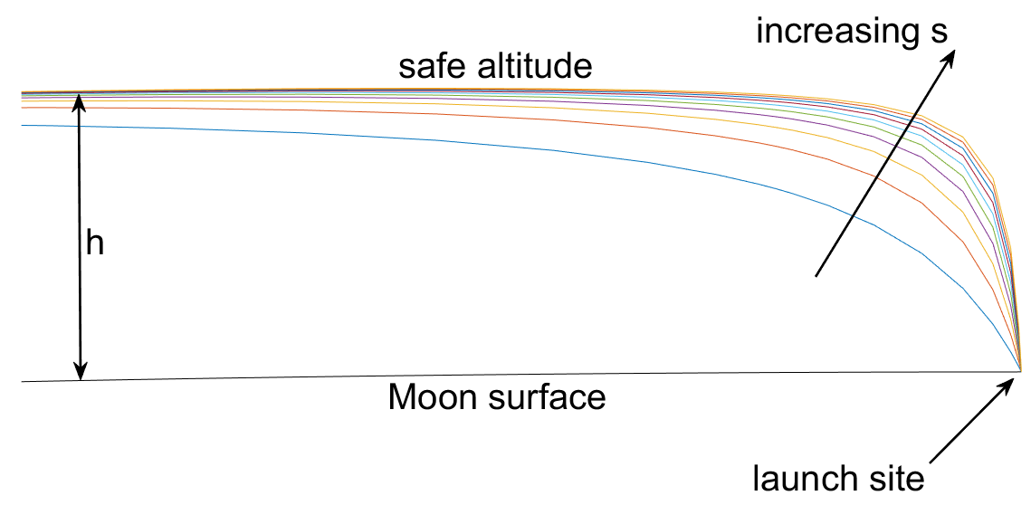
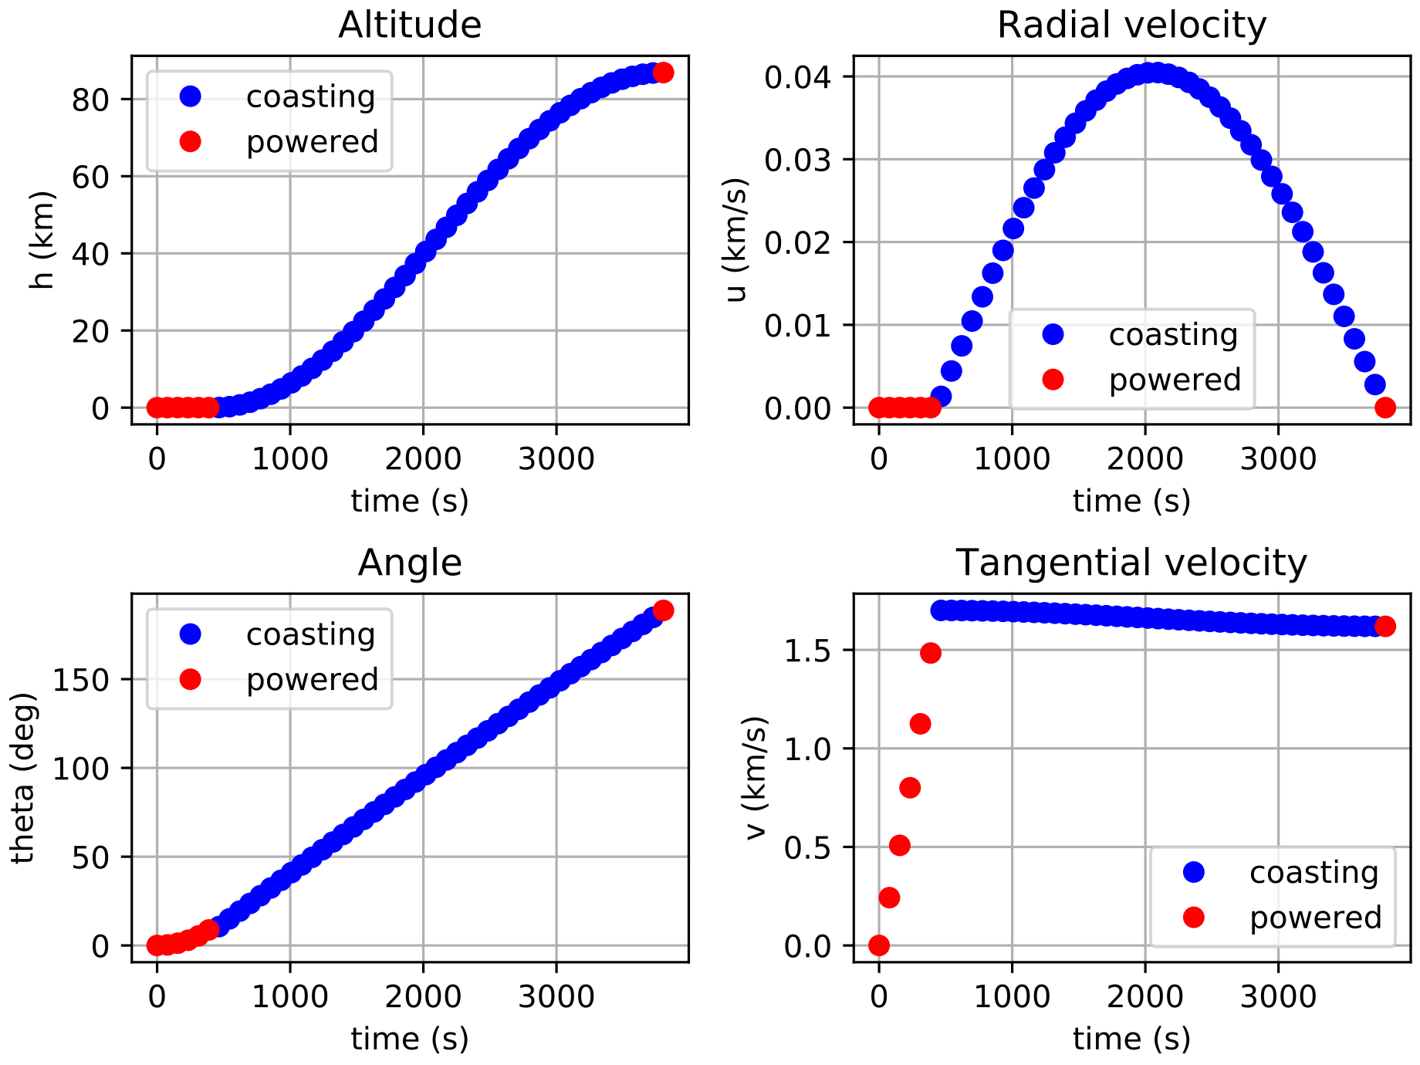
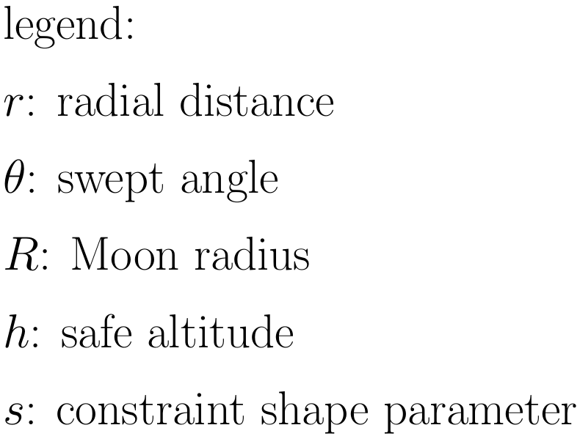
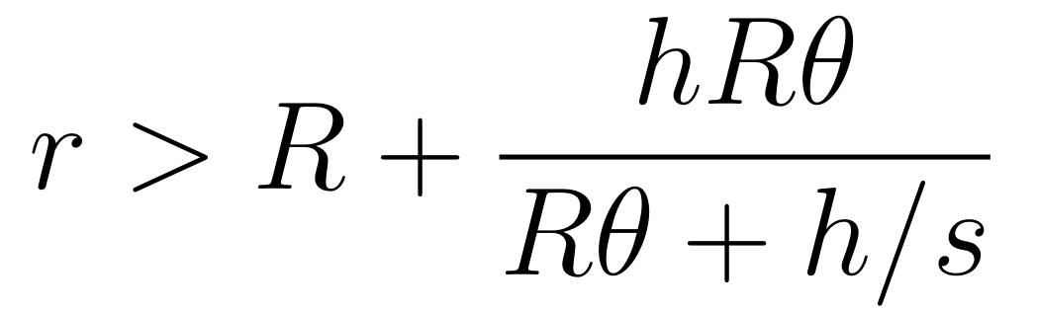
2D Ascent: Minimum safe altitude
Path constraint to avoid lunar highlands:
Seminanalytic initial guess:
Three-phases trajectory:
powered phase at constant radius r=R
Hohmann transfer
impulsive injection burn

Slide 16
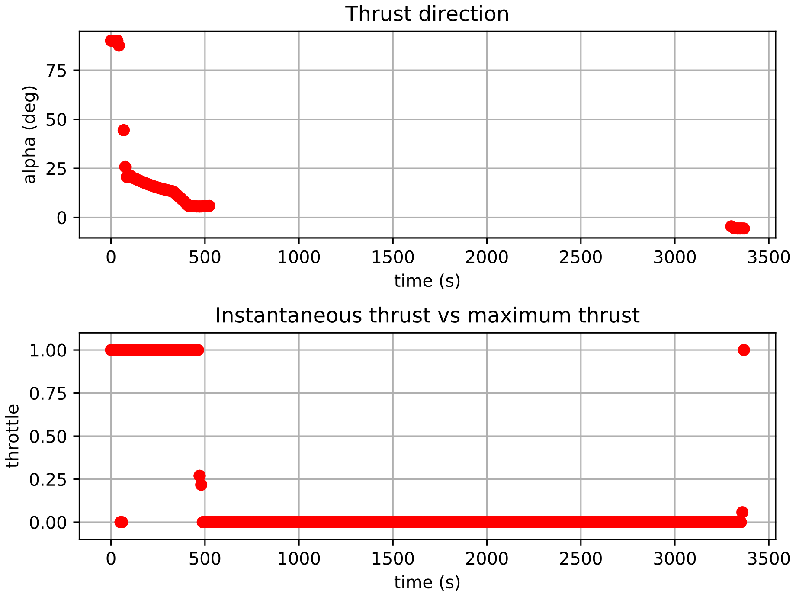
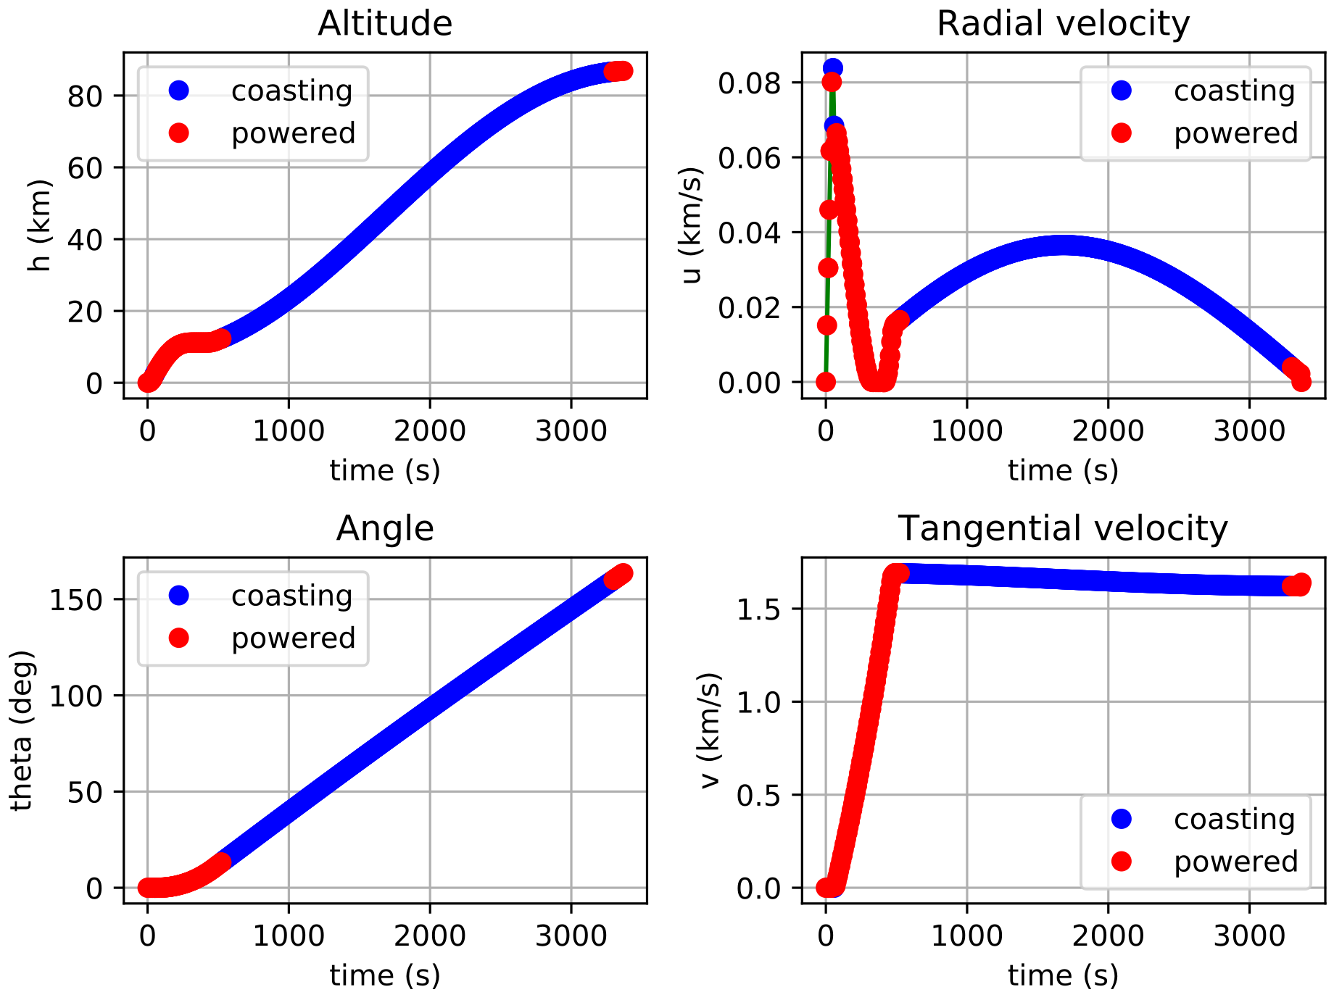
2D Ascent: Minimum safe altitude
Ascent Trajectory | Time of Flight | Propellant consumption
Initial guess | 3803.26 s | 32.81%
Variable Thrust, Minimum safe altitude | 3367.77 s | 35.50%

Slide 17
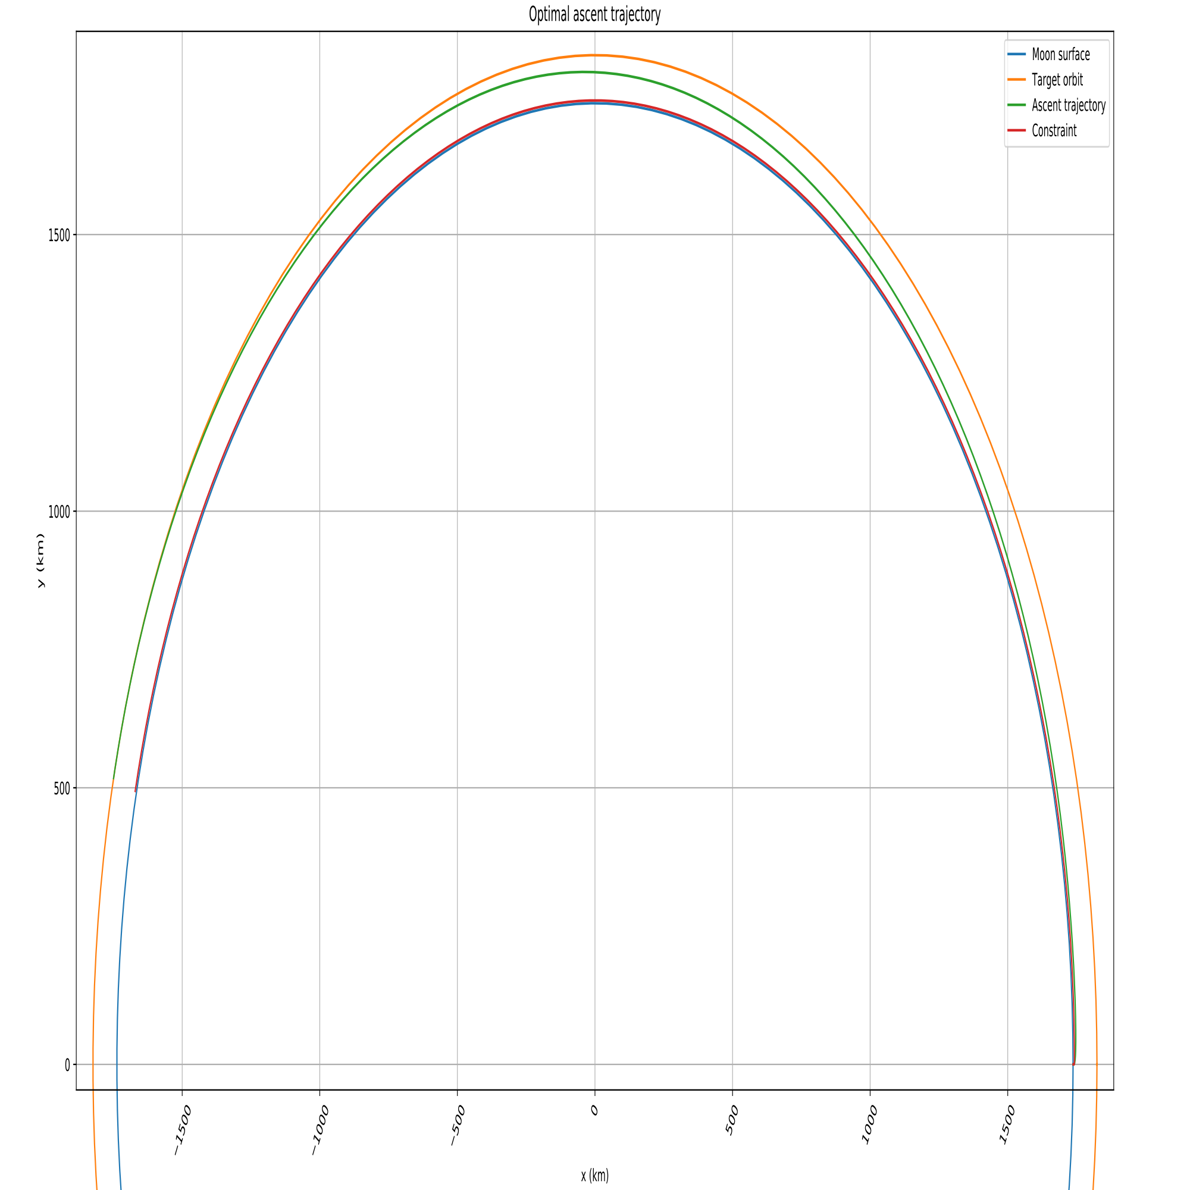
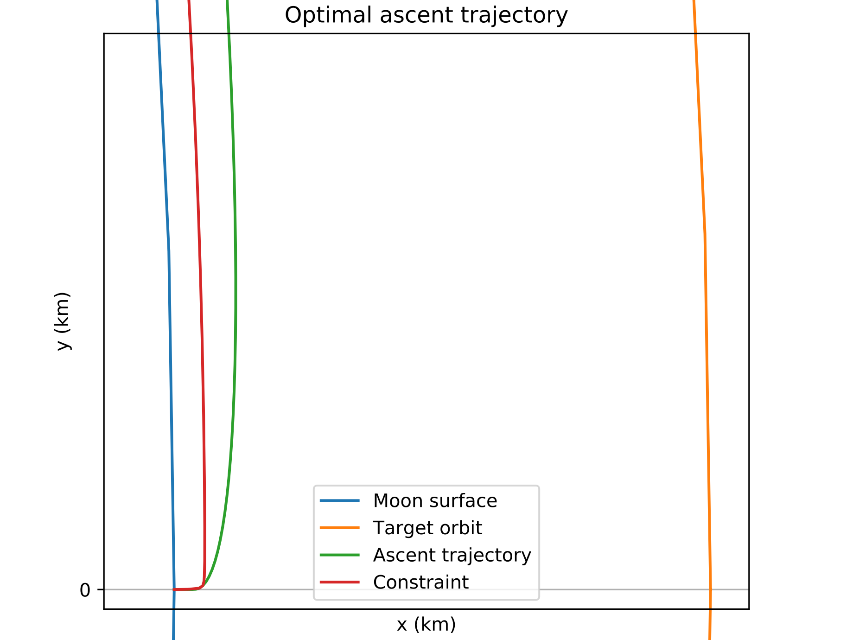
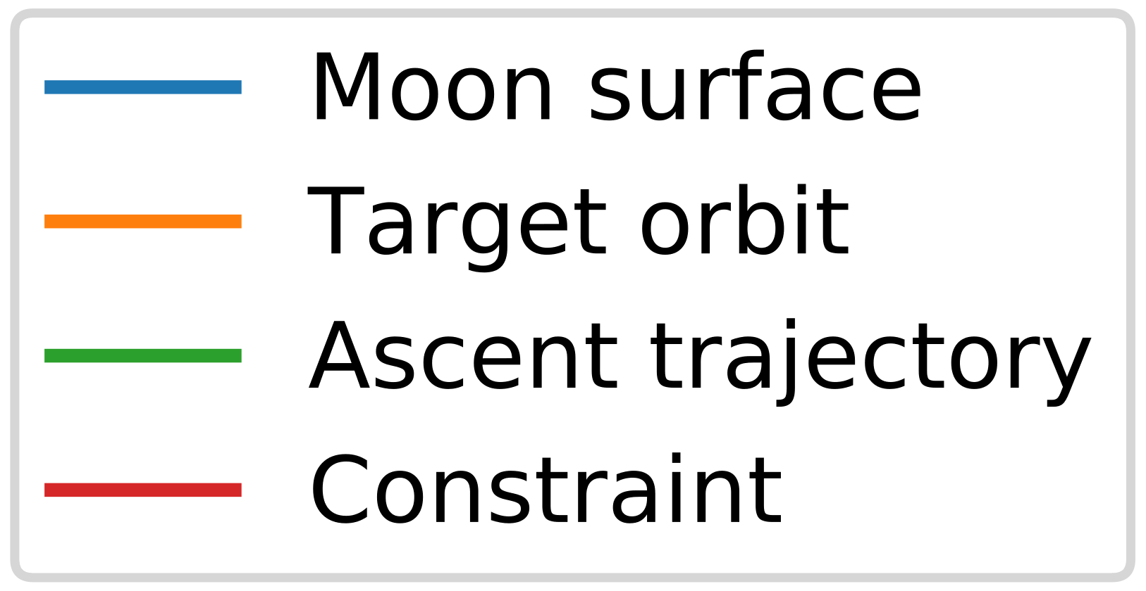
2D Ascent: Minimum safe altitude
h | 5.0 km
s | 100

Slide 18
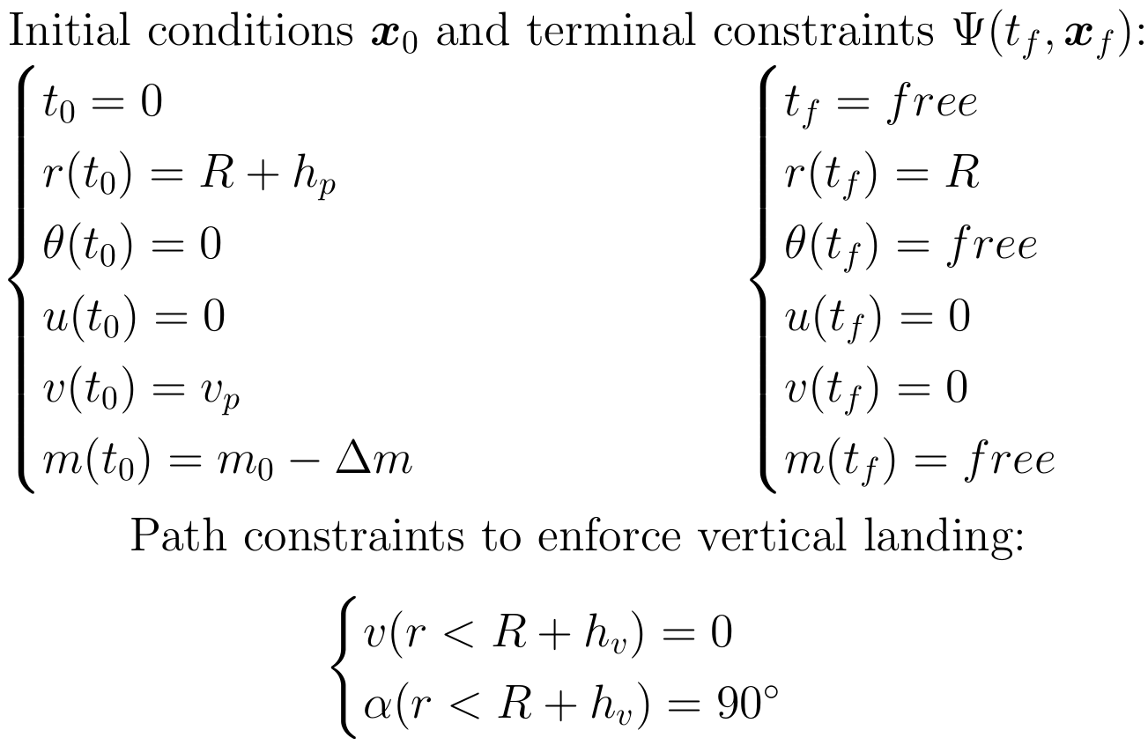
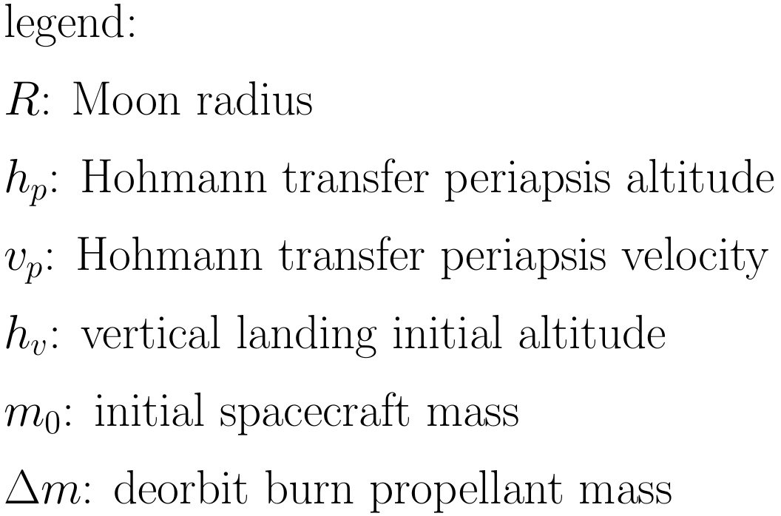
2D Descent: Optimal control problem

Slide 19
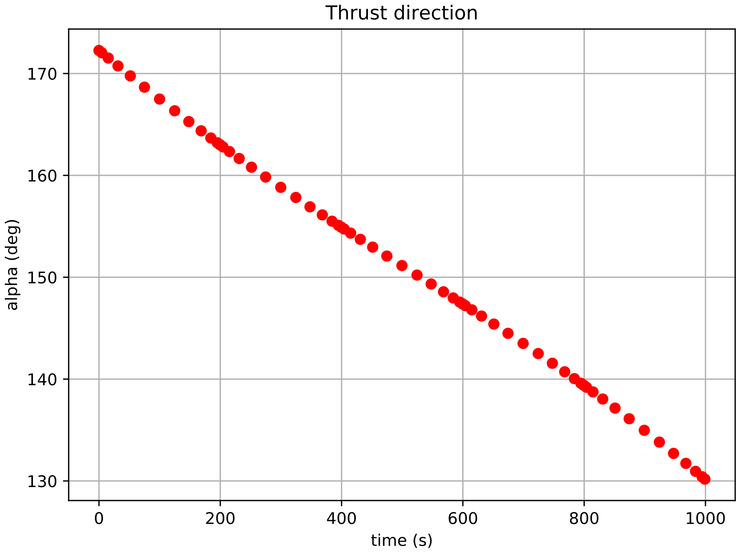
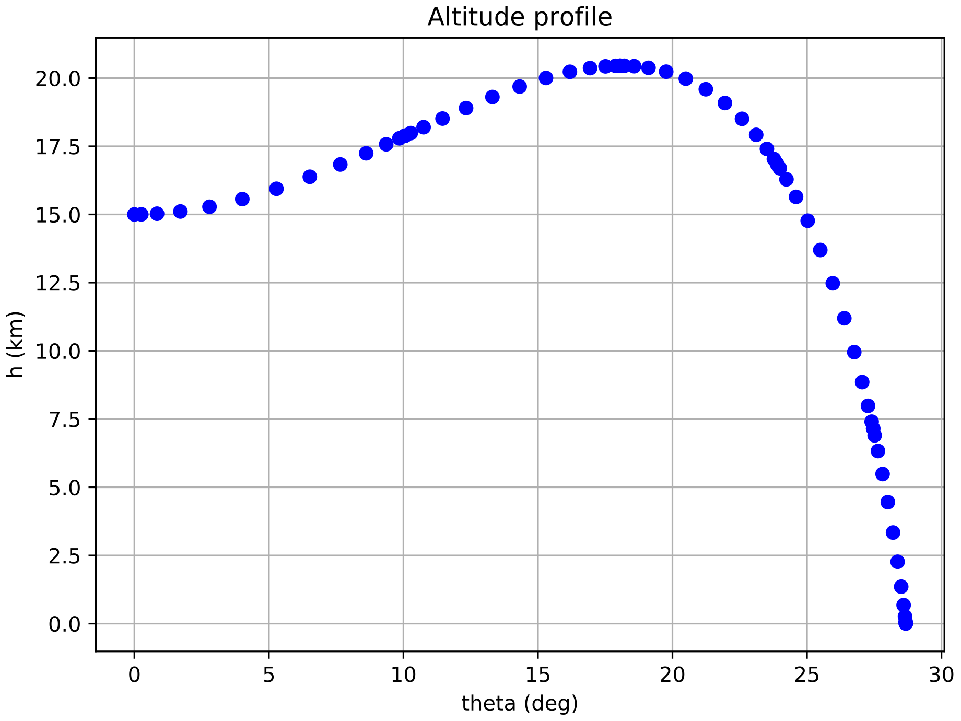
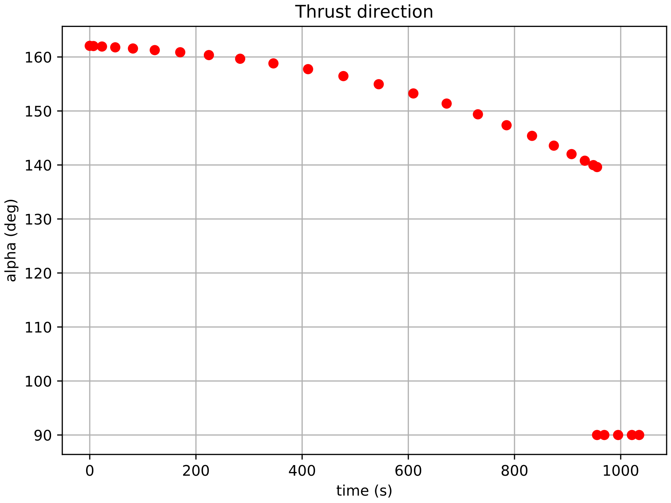
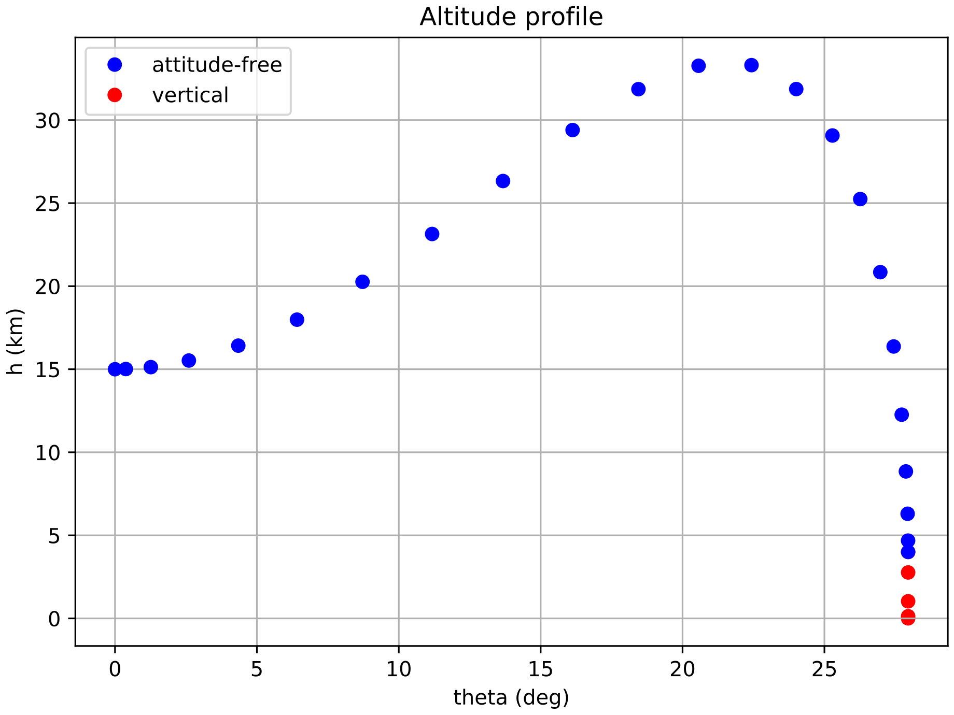
2D Descent Trajectory
Descent Trajectory without final constraints
Descent Trajectory with final constraints
Parking orbit altitude | 100 km
Powered descent phase initial altitude | 15 km
Vertical phase initial altitude | 4 km
Isp | 310 s
initial thrust/weight ratio | 0.90
 | Time of Flight | Propellant consumption
Free | 999.05 s | 48.51%
Vertical constrained | 1034.77 s | 50.24%

Slide 20
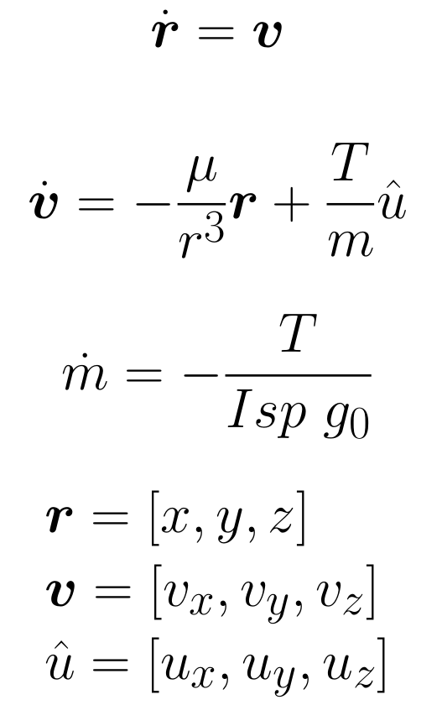
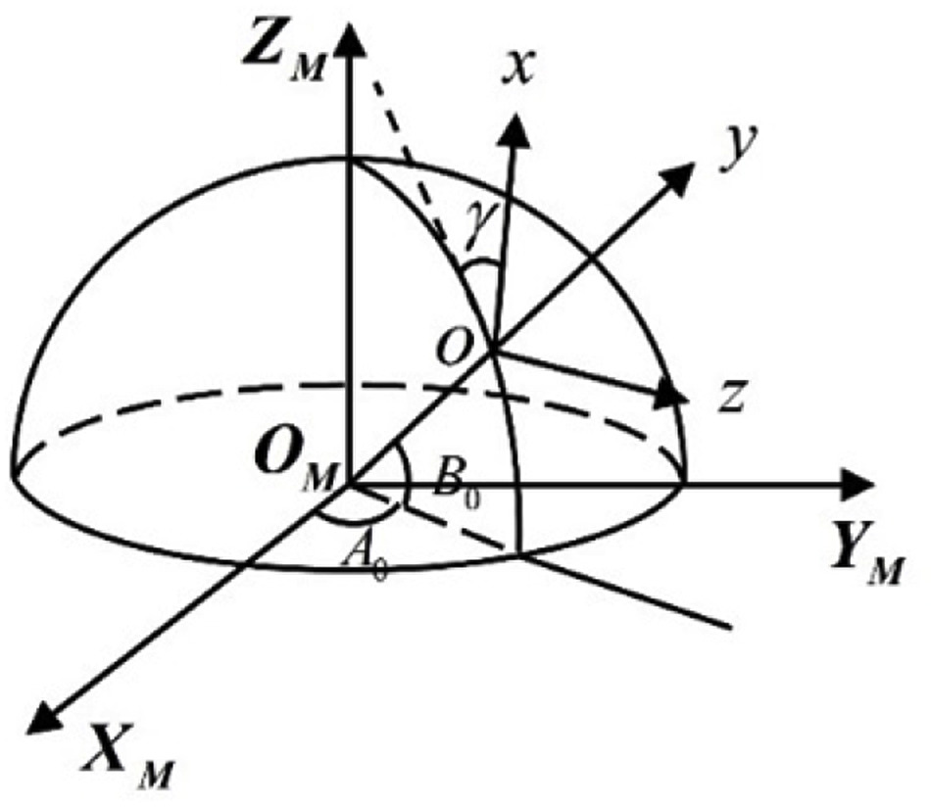
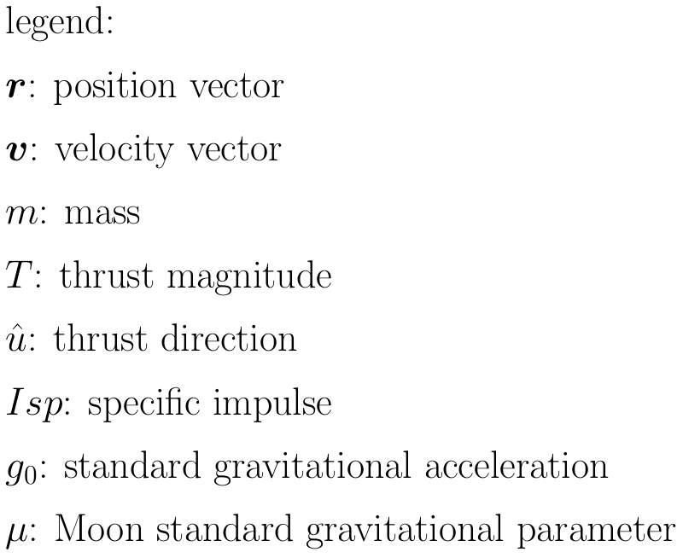
3D Ascent: EOMs
Equations of motion (EOMs):

Slide 21
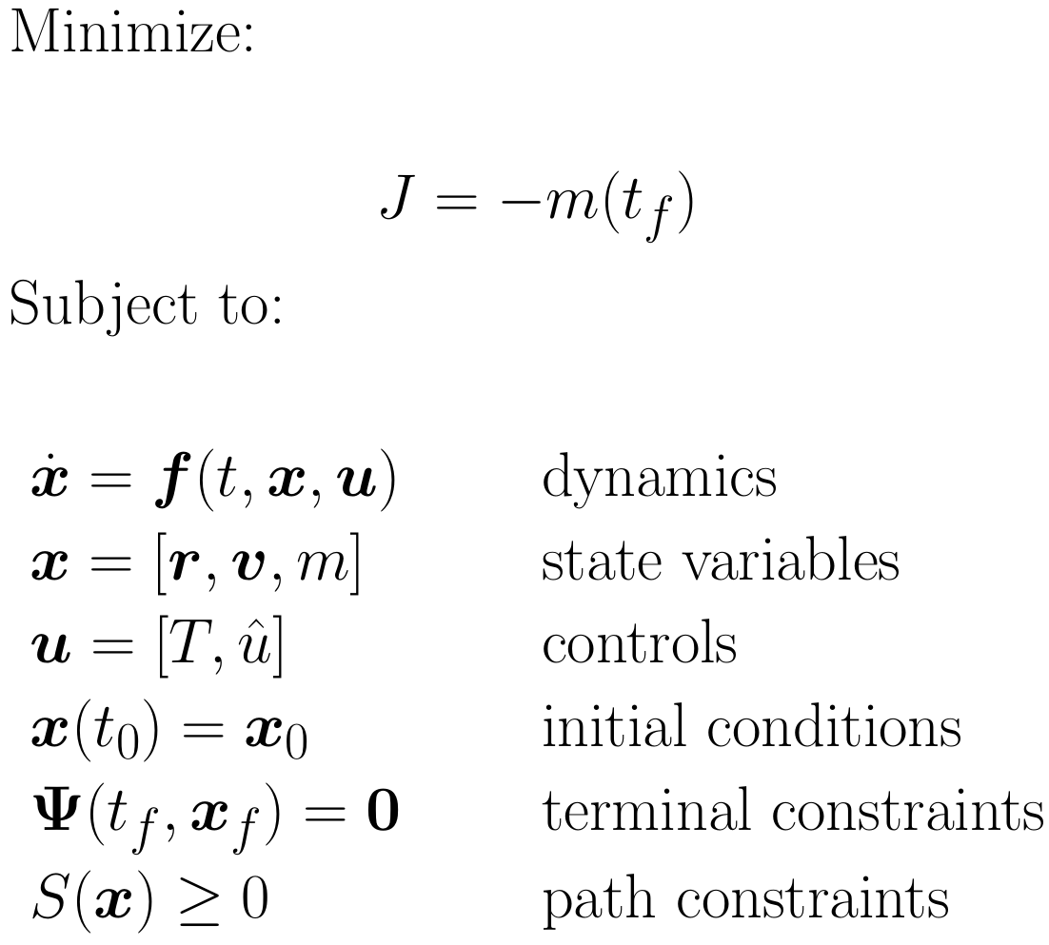
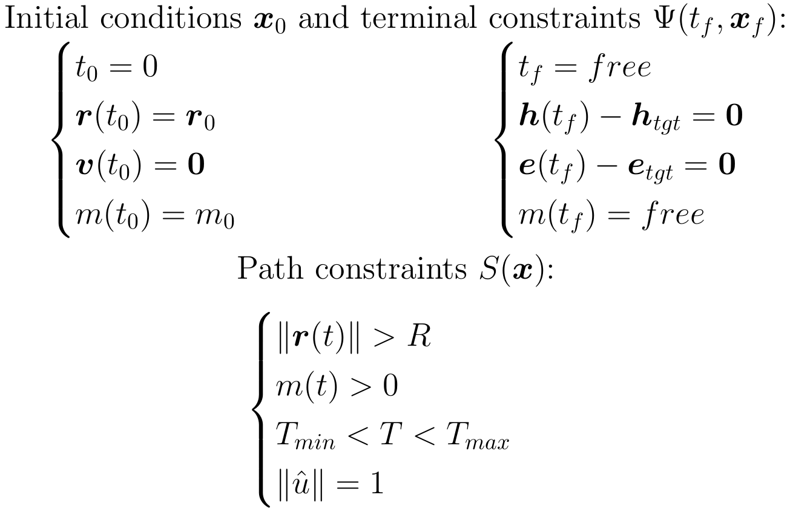
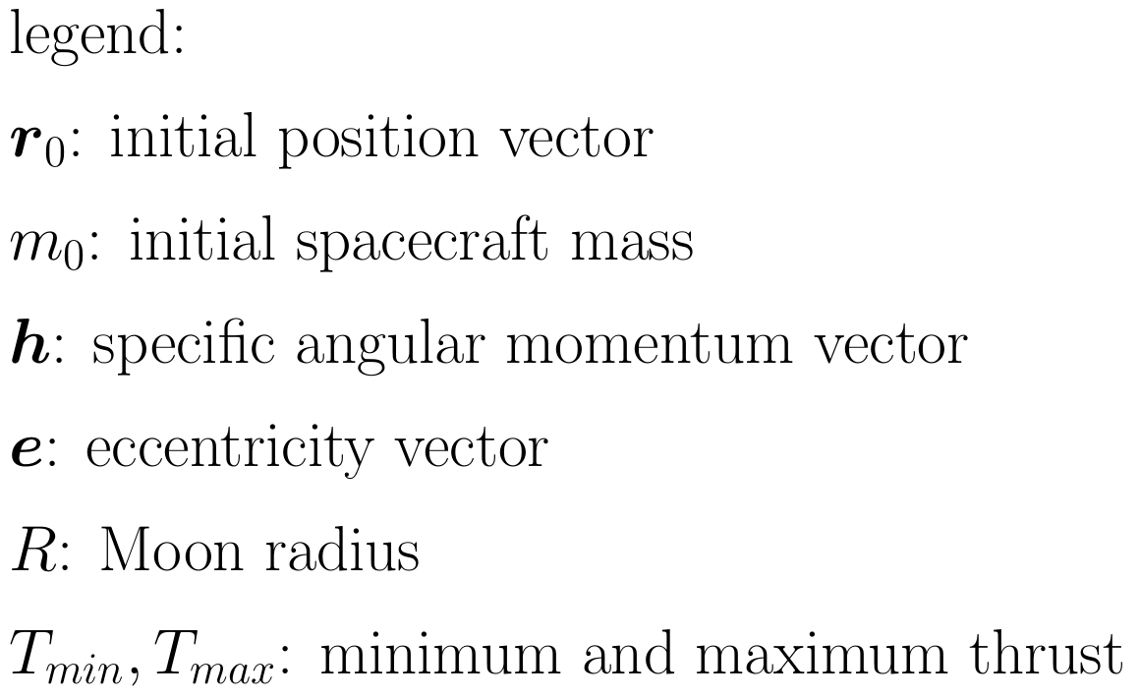
3D Ascent: Optimal control problem

Slide 22
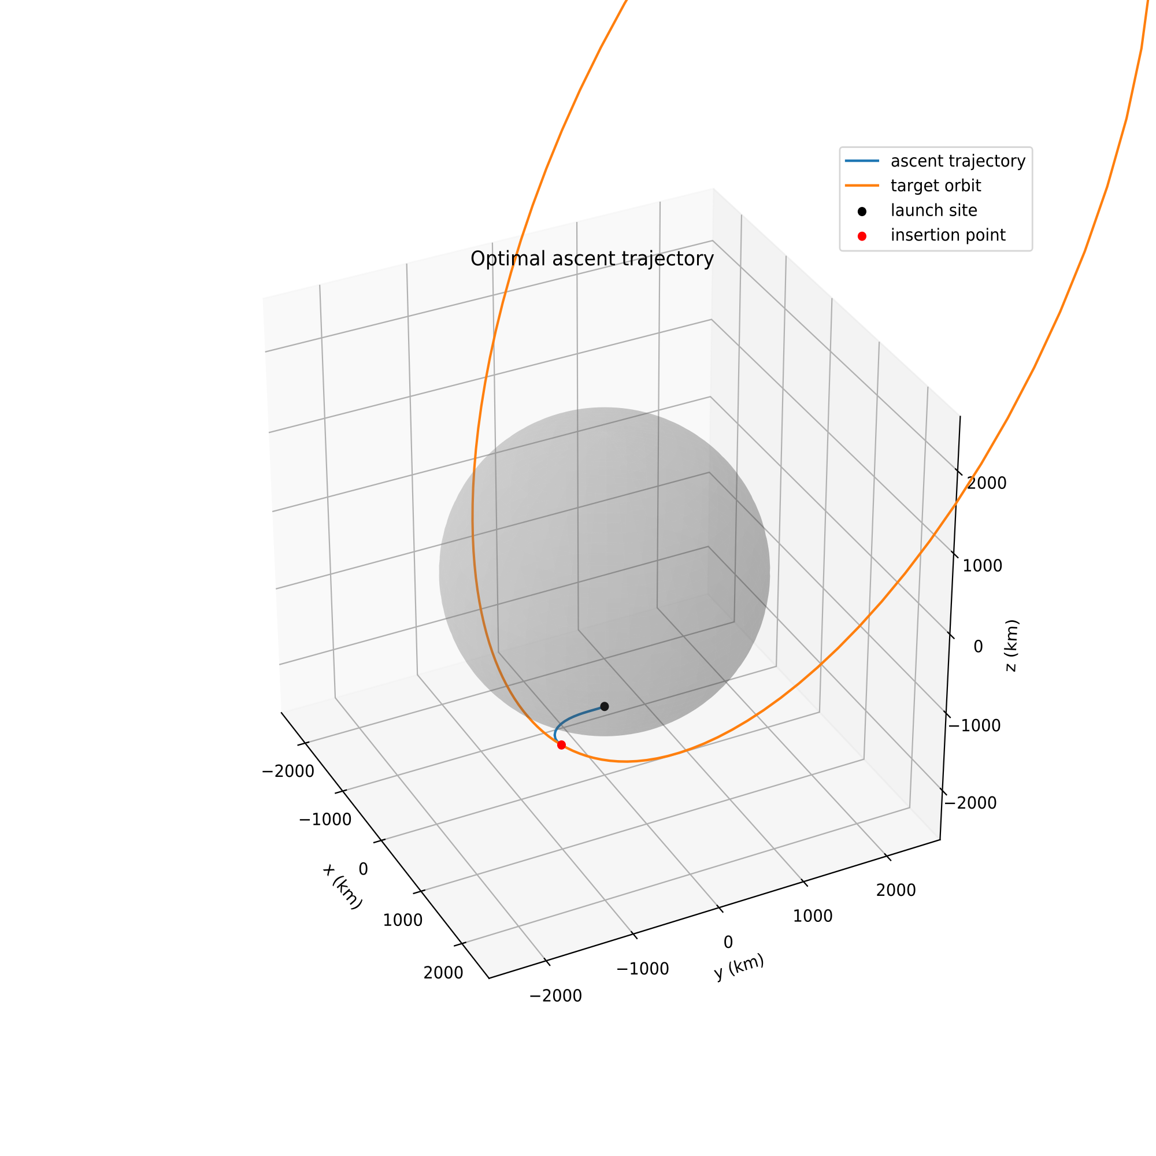
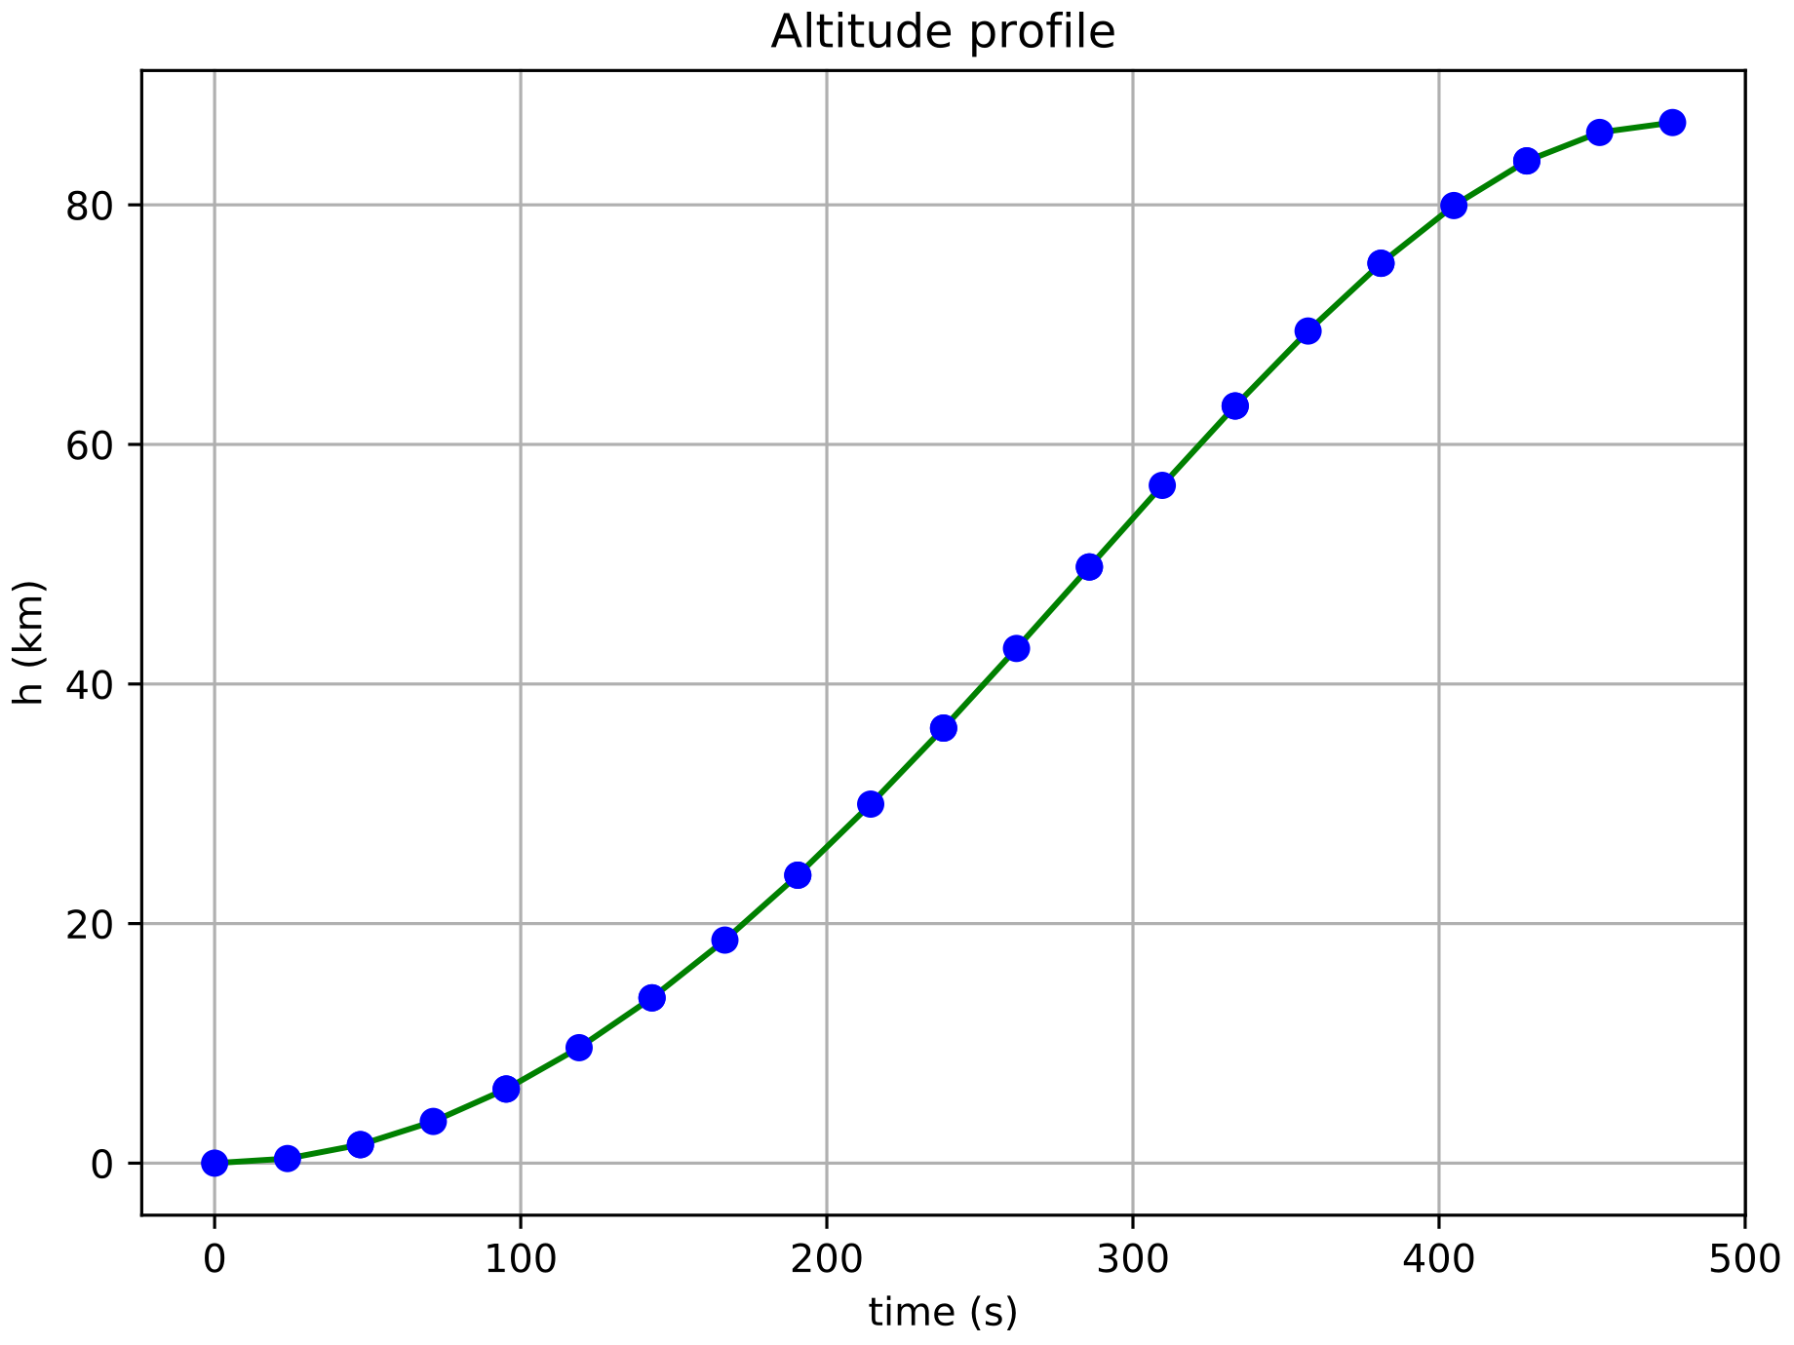
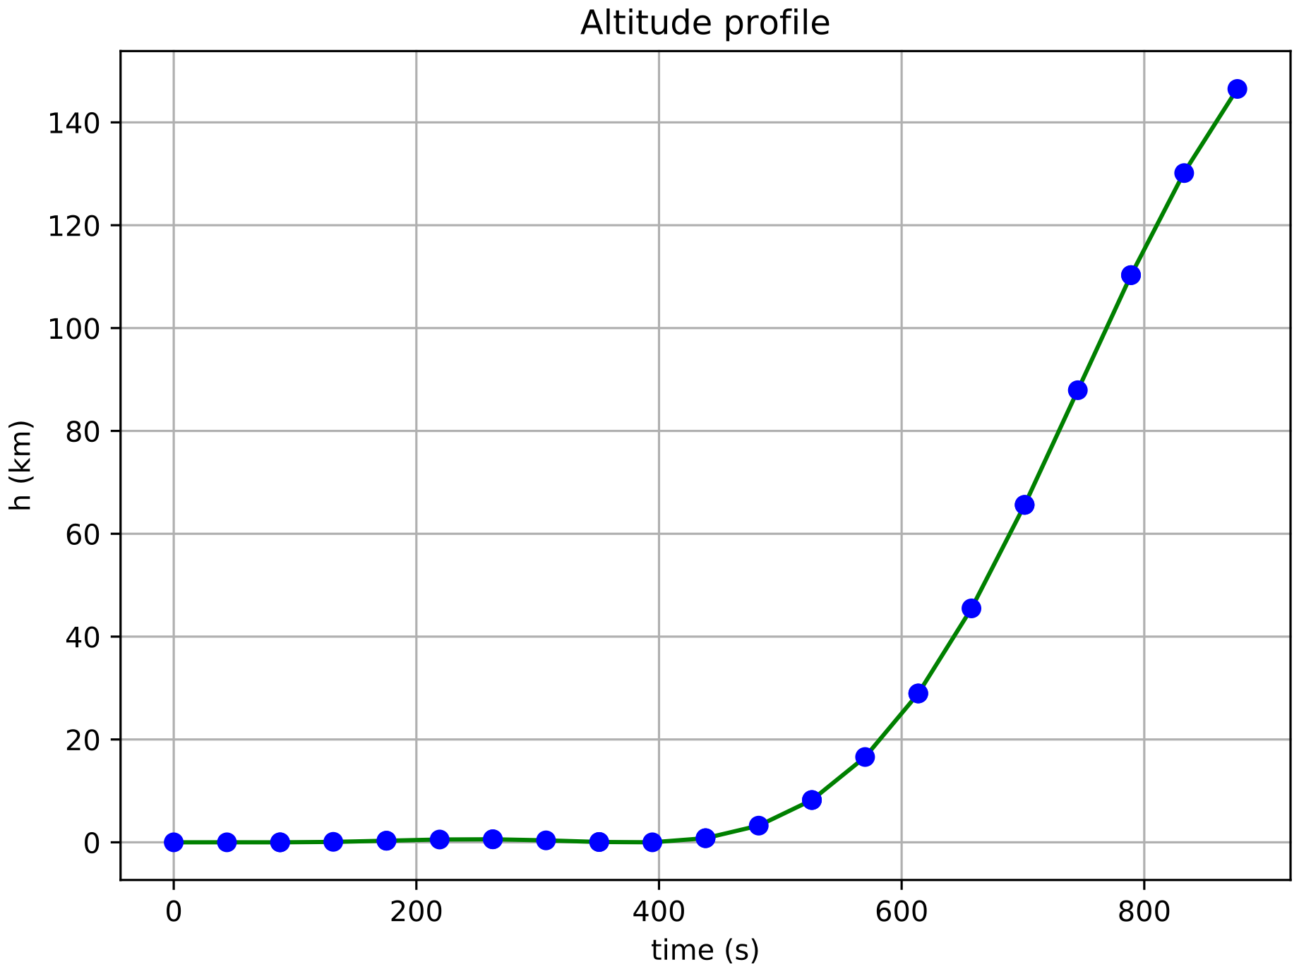
3D Ascent: Constant thrust
Polar orbit - coplanar transfer
Highly elliptical orbit - out-of-plane manoeuvre
Type of orbit | Eccentricity | Inclination | Argument of perilune | Semimajor axis | Time of flight | Propellant consumption
Polar | 0 | 90° | - | 1824.27 km | 476.29 s | 36.81%
Higly elliptical | 0.7 | 60° | 270° | 6080.90 km | 876.73 s | 67.76%

Slide 23
Conclusions & Future achievements
3D ascent trajectory improvements:
Variable thrust
Limits on attitude rates
Constraints on ground clearance
Other developments:
3D descent trajectory
High fidelity gravity model
Moon rotation
Main issues:
Understanding OpenMDAO/dymos framework
Inadequate NLP solvers (SLSQP)
Poor State of the Art
Difficulties while selecting correct transctiption
High sensitivity to variables scaling

Slide 24
Selected bibliography
Benson, David. A Gauss Pseudospectral Transcription for Optimal Control. Massachusetts Institute of Technology, 2005, https://dspace.mit.edu/handle/1721.1/28919.
Find Minimum of Constrained Nonlinear Multivariable Function. https://www.mathworks.com/help/optim/ug/fmincon.html?s_tid=srchtitle.
Gill, Philip E., et al. ‘SNOPT: An SQP Algorithm for Large-Scale Constrained Optimization’. SIAM Review, vol. 47, no. 1, Jan. 2005, pp. 99–131. doi:10.1137/S0036144504446096.
Gray, Justin S., et al. ‘OpenMDAO: An Open-Source Framework for Multidisciplinary Design, Analysis, and Optimization’. Structural and Multidisciplinary Optimization, vol. 59, no. 4, Apr. 2019, pp. 1075–104. doi:10.1007/s00158-019-02211-z.
Hendricks, Eric S., et al. ‘Simultaneous Propulsion System and Trajectory Optimization’. 18th AIAA/ISSMO Multidisciplinary Analysis and Optimization Conference, American Institute of Aeronautics and Astronautics, 2017. doi:10.2514/6.2017-4435.
HSL, A Collection of Fortran Codes for Large Scale Scientific Computation. http://www.hsl.rl.ac.uk/.
Longuski, Jim, et al. Optimal Control with Aerospace Applications. Springer ; Published jointly by Microcosm Press, 2014.
Ma, Lin, et al. ‘Trajectory Optimization for Lunar Rover Performing Vertical Takeoff Vertical Landing Maneuvers in the Presence of Terrain’. Acta Astronautica, vol. 146, May 2018, pp. 289–99. doi:10.1016/j.actaastro.2018.03.013.
Patterson, Michael A., and Anil V. Rao. ‘GPOPS-II: A MATLAB Software for Solving Multiple-Phase Optimal Control Problems Using Hp-Adaptive Gaussian Quadrature Collocation Methods and Sparse Nonlinear Programming’. ACM Transactions on Mathematical Software, vol. 41, no. 1, Oct. 2014, pp. 1–37. doi:10.1145/2558904.
Ramanan, R. V., and Madan Lal. ‘Analysis of Optimal Strategies for Soft Landing on the Moon from Lunar Parking Orbits’. Journal of Earth System Science, vol. 114, no. 6, Dec. 2005, pp. 807–13. doi:10.1007/BF02715967.
Shirazi, Abolfazl, et al. ‘Spacecraft Trajectory Optimization: A Review of Models, Objectives, Approaches and Solutions’. Progress in Aerospace Sciences, vol. 102, Oct. 2018, pp. 76–98. doi:10.1016/j.paerosci.2018.07.007.
Topputo, F., and C. Zhang. ‘Survey of Direct Transcription for Low-Thrust Space Trajectory Optimization with Applications’. Abstract and Applied Analysis, vol. 2014, 2014, pp. 1–15. doi:10.1155/2014/851720.
Wächter, Andreas, and Lorenz T. Biegler. ‘On the Implementation of an Interior-Point Filter Line-Search Algorithm for Large-Scale Nonlinear Programming’. Mathematical Programming, vol. 106, no. 1, Mar. 2006, pp. 25–57. doi:10.1007/s10107-004-0559-y.

Slide 25
Thank you for your attention
Any question?

